Slide 1
Eastern Political Thought
Manu : Rajdharma
According to mythology Manu was the first person on the earth. He is also known as first lawgiver of India who codified the law. He wrote Manava Dharmashastra or Manusmriti. It consists of 2685 versus. They cover the discussion on social obligation, duties of the various varnas & individuals at different stages of life. It is the synthesis of philosophy religion & law focusing on a very wide yet complex world view.
Sir William jones translated Manu Smriti in English.
Some Historians have argued that the laws of Manu were composed by Brahmins for their exclusive use. i.e to support the Brahmin dynasties that arose instead of Kshatriyas. Also the ideas of Manu written in Manusmriti was already prevalent he codified those idea & codified them.
Sapta Anga theory of Manu
Seven limbs (prakriti) of state
In Manusmriti Manu deals with seven prakrits of the state.
King
The Ministers
The Capital
The realm
The Treasures
The Army
Ally

Slide 2
Manu : Rajdharma
Swamin (King /Ruler)- Most important limb of the state. King is the sovereign ruler of the kingdom. He is created by the blessing of Gods like. The king had the Divine right to rule. Thus, Manu is evoking Divine right theory. He the person responsible to protect the social order. He is a symbol of Justice
AMATYA- Manu advices his king to be careful of the formation of council of ministers because such ministers constitute the government. The king should appoint 6 or 7 carefully examined ministers. He should choose ministers who are learned, brave & skilled in the use of weapon. He should discuss with them the matters of peace & war, conditions of the kingdom, wealth, protection of the territory etc
Janapada – The king should have permanent territory. The territory must have predominance of Brahmans. If it is dominated by the Shudras, then the territory would suffer and face famines & diseases.
Pura- Manu suggested for a town fortified by desert or water or even trees or by armed men or by mountains.
Kosha- The treasury of the kingdom. The king should appoint pure men to take charge of kosha which involves both the income & expenditure of the kingdom, collection of revenue, mines, especially gold mines etc.
Bala (Army)- There should be a strong army to protect his kingdom when in attack
Mitra- Should have friendly allies.

Slide 3
Manu : Rajdharma
Theory of Kingship-
Manu’s theory of kingship revolves around king’s duty to maintain proper functioning of Varna. That each of the four Varna should perform its respective duty.
Manu also talks about the concept of Karma. He asserts that if follow social codes of conduct defined via Varna system they would attain a heavenly state and their good deeds in this world would result in prosperous next life
Manu on Kingship, Manu believed that God created the king to save the people of a region. The King held a divine position and the people expressed their obedience to him because of his authority. Manu stated that the king appeared in human form and possessed the qualities of God.
Qualities of a King: According to Manu the king is the next best to God and he must have complete control over himself and his senses. He is a divine creation and his purpose is to promote social harmony, peace and welfare. King possesses certain qualities like Indra (God of War), Vaayu (God of Wind), Yama (God of Death), Ravi (God of Sun), Agni (God of Fire),Chandra or Moon, and Wealth.
The king was described as an embodiment of eight guardians on earth. A king was expected to control his anger, satisfy the people and govern the state with their consent rather than the use of force.

Slide 4
Manu : Rajdharma
The king must exhibit those qualities of Sama, Dama, Dand & Bhed that naturally make citizens obey him, and he must function through pleasing manners and intelligence. Manusmriti strongly advocated for a political authority. Manu suggested that though the king derived his authority from God, in practice he should be guided by the brahmanas. The rationale behind it was the assumption that brahmanas possess knowledge and knowledge should rule.
Council of Ministers: Manu viewed that the council of ministers were a very important part of a king. King without the council of ministers is like driving a chariot without wheels. The council of ministers were like the arms, eyes, ears of the king.
The ideal number of council of ministers should be not more than seven to eight who collectively and individually assist and advise the king to discharge his daily duties. Manu opined that the council of ministers must possess certain essential qualities. They must possess high learning skills, must be men from high caste by birth, good warriors with a sharp understanding of various techniques of warfare and proper comprehension of state system and the like. A minister is said to be an honest mediator between the king and his subjects.
The selection of ministers must be through hereditary principle, but the skills and qualities must be put in test before appointment. Manu opined that ministers were generally appointed by the king with advice from his friends and relatives.
However, no shudra was allowed to become ministers.

Slide 5
Manu : Rajdharma
Manu on Varna System
Manu viewed that caste system formed an essential part in ancient Hindu society. Varna system would preserve the social harmony of the society. He viewed that the king came into existence to protect the Varna system and any failure on the part of the ruler would make him unworthy ruler. Manu opined that there is a fourfold categorization of social organization derived from the Vedic rhymes. They are Brahmanas, Kshatriyas, Vyshyas and Shudras. It is widely viewed that these four Varnas represented four different parts of the body of the God. The Brahmanas rise from the head, the Kshatriyas from the arms, the Vyshyas from the thighs and the Shudras from the feet.
The Brahmanas occupy the highest place and they are conceived as the incarnation of the law. The superior place given to the Brahman in the social hierarchy is due to the purity and knowledge. The Kshatriyas were expected to protect the state by their valour, offer sacrifices as well as gifts and protect the people.
Manu viewed that a society would be more secure if there is a harmonious relation between the Brahmanas and the Kshatriyas. The Vyshyas were involved in trade and business whereas Shudras were only confined to serve the upper three castes. Manu said that the shudras must be barred from all social and sacred learning. The fourfold classification was called the Chaturvarna theory.

Slide 6
Arthashastra by Kautilya
Kautilya’s work Arthashastra belongs to the tradition of dandashasra. The prime issue in Arthashastra is statecraft. However it also discusses dharma and we see the continuity between Manu and Kautilya.
Kautilya defines statecraft as Arthashastra. Artha denotes material well-being. According to Kautilya, the most important objective of the king is to secure the material well-being of its people. In the words of Kautilya, “Material well being is supreme, attainment of all other goals dharma, kama, moksha depends on material well being.” In ancient times, land was the main source of securing the material well being. Hence the main idea in Arthashastra is how to acquire the land. It is natural for a state to go for acquiring land. The first land to be acquired is the land of neighbor. Hence neighbors are natural enemies and the relations between the two states are the relations of war. Thus Arthashastra deals with ‘art of war’ like Sun Tzu the Chinese strategist. Hence the main idea in Arthashastra is war, strategic planning, balance of power, geopolitics. Arthashastra can be considered as the first textbook in geopolitics. (geopolitics is a science of capturing land/resources.) According to the concept of geopolitics, state is an organism. Like any organism, state has to grow. If state will not grow/expand, state will perish or decay. Thus Kautilya’s Arthashastra challenges western view that Indians lacked strategic culture. George Tanham categorically rejected that Indians have any strategic culture or wisdom but Kautilya proves him wrong. It is unfortunate that policymakers in India have overlooked the wisdom found in Arthashastra. However since the beginning of 21st century, with Hindu rightist party coming to power, there is a change in the approach of the south block. We are rediscovering the ancient Indian wisdom.

Slide 7
Arthashastra by Kautilya
Main ideas in Arthashastra. 1) State of relations between the two countries. 2) Mandal siddhant. 3) Saptanga theory. (Saptaprakar theory) 4) Sadgunya Niti. (Six fold policy) 5) 4 upayas. (Fourfold policy) 6) Types of wars.
State of relations.
According to Kautilya, the relations between the two states are the relations of war, where the strength of lion prevails. Thus Kautilya is a realist who believes that interstate relations are the struggle for power. According to realist wisdom, interstate relations or international politics is a state of war. Nations are either in the war or in the preparation of war. Hence in such situations state can rely only on power. Kautilya belongs to the school of ‘offensive realism’. He believes in power maximization rather than defense maximization. For offensive realists, offence is the best defense.
Mandal Siddhant.
Context of the mandal siddhant, rajdharma i.e. kshatriya dharma. Kshatriya dharma is war, hence after coronation king has to start for expedition. In ancient India there was tradition of different yajnas, like Asvamedha yajna, Rajasuya yajna. According to Kautilya, king should have the desire to become Chakravarthi Samrat. He addresses the king as Vijigishu means one who aspires for victory.

Slide 8
Arthashastra by Kautilya
Kautilya’s ideas on warfare
War is inevitable feature of inter-state relations. War is Kshatriya dharma. War is necessary for the material well-being. King should aspire to become Chakravarti Samrat. (It means King should strive to achieve hegemony and not just balance of power.)
According to Kautilya, there can be three types of wars depending on the situation. Parakrama yuddha – means open war. Koot yuddha – gorilla war. Tushnim (silent) yuddha – proxy war.
Kautilya also mentions three types of victories. Dharma Vijaya – as per rules of war. Lobha Vijaya – by giving economic inducement to the enemies forces. Asura Vijaya – by cunningness or unfair means.
Kautilya also gives Shada gunya Siddhanta. (Six fold policy). Vijigishu should opt for 1. Sandhi (If enemy is strong.) 2. Vigraha (Break the Sandhi, start war if you are strong.) 3. Asana (Stationing of the forces near enemies territories.) 4. Yana (Sanskrit word for mobilization – it means military exercise near enemies territory.) 5. Samashraya (Joining hands with those who have similar aims, like Quad.) 6. Dvaidhbhava (Dual policy – it means friendship with one enemy for the time being and enmity with the other – don’t open two fronts at the same time.)

Slide 9
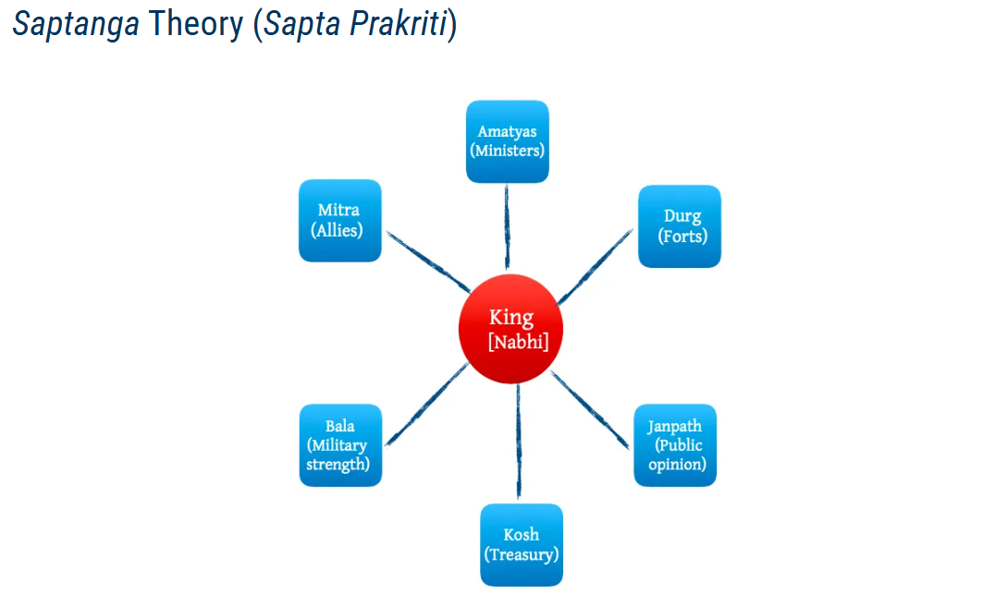
Arthashastra by Kautilya

Slide 10
Arthashastra by Kautilya
1] King
King is center. All other elements depend upon King. According to Kautilya, if King is smart and other elements of sovereignty are weak, he can convert these elements into the elements of strength. On the other hand, if king is not smart, lacks courage but other elements of sovereignty are strong, then also these elements will not be able to play the role of determinant of power. This shows the importance of leadership. Kautilya’s views on kingship have a huge continuity with Manu’s views on kingship. However Kautilya is not specific about the varna of the king, he suggests person from any varna to be eligible for the king. Though king plays the most important role in the system, yet king needs to understand that single wheel cannot turn the chariot of the state. It means king cannot rule alone, king needs the help of other elements, hence king should give adequate importance to the other elements. Thus he takes the organic view that the state is not just the sum of parts, state is an interdependence though the king retains primacy. He warns against arrogance. Arrogant king will destroy himself.
2] Amatyas
Amatyas are the senior ministers, preferably bramhins. Required for consultation. Should be well versed in Vedas, Shastras. Out of all amatyas, the most important role is of ambassador. King should be particular about choosing the ambassador. Ambassador is the representative of the king to the outside world. Thus next to king in importance. Ambassador should be well versed, man of integrity, should be dedicated towards the king. Ambassador should be handsome. He suggests, king should have at least three amatyas because two can easily conspire against the king. King should keep on testing the integrity of the amatyas because they can be potential challenge. He gives detailed measures to check the integrity. e.g. he gives suggestion to send spies to amatyas with the message that queen is in love with amatya, if amatya will come to palace, queen will help amatya in killing the king and then amatya can become the king.

Slide 11
Arthashastra by Kautilya
3] Forts / Durg
Mauryans were known for fortifications. Forts are the symbols of the offensive and defensive powers of the state. Kautilya advices to construct different types of forts that include hill forts, water forts, desert forts.
4] Janpaths
Janapath represent the heart of the state. It is a place where common man/ citizens lives. It is a place for economic activities. It is the duty of the king to take care of the needs of janapath. King should treat his citizens as his children. In the words of Kautilya, “In the happiness of the subjects, lies the happiness of the king.” At the same time, Kautilya advices king to keep track of the public opinion by using spies to prevent rebellion.
5] Kosh / Treasury
Kosh of the state should be enough not just for meeting day-to-day expenditures but to meet any sort of calamity, whether it is war, or natural disasters.
6] Bala (Force)
Kautilya prefers the army of Kshatriyas. However if need arises, other varnas can also be included. King should have sufficient army and should always keep the morale of the army high.
7] Mitra (Allies)
Mitras have symbolic importance. When a person has lot of mitras, it shows that the person is powerful. Hence it is a symbol of power to be the friend of strong.

